Slide 1
Zowe Consumption Survey Results 11/29/18

Slide 2
Key Insights
Installation is a challenge
SysProgs have little time to devote to installing Zowe
Trust is not a challenge for respondents to consume Zowe
Documentation is incomplete
Pre-reqs (Node and z/OS MF) are hard to install
Community members want and need access to a free z/OS instance
DevOps and Development are the expected primary use cases for Zowe
30% of respondents (community members) are not engaged or cannot access Slack
Respondents expect to re-engage with Zowe once it is “more mature”

Slide 3
Survey Metrics
ISVs
22 Respondents
83% (18) said they are interested in building extension, but only 13% (3) have plans to build anything in the next 3-6 months
Sponsor Users
4 Respondents
50% (2) have issues installing Node, 25% (1) have issues installing z/OMF
OMP Community
9 Respondents
55% (5) had installed Zowe and had issues with needing multiple tools to complete install
13% (3) are actively engaged in the community
40% (9) are waiting for market validation before investing
66% (15) said they would consider using an IBM PID
25% (1) was actively engaged in the Zowe community on Slack
100% of respondents expect to use Zowe for Dev and 75% say DevOps
50% plan to consume Zowe through commercial offerings, 50% plan to consume Zowe via writing their own extensions
Time to work on open source is the biggest challenge for adopting Zowe, Trust in community/code is the least challenging
66% (6) are actively engaged in the Zowe community on Slack
55% (5) expect to use Zowe for Dev.
44% (4) plan to consume Zowe through writing their own extensions as well as consume Zowe through commercial offerings
Zowe is not mature enough is the biggest challenge for adopting Zowe, Trust in community/code is the least challenging

Slide 4
Back-up and Survey Responses

Slide 5
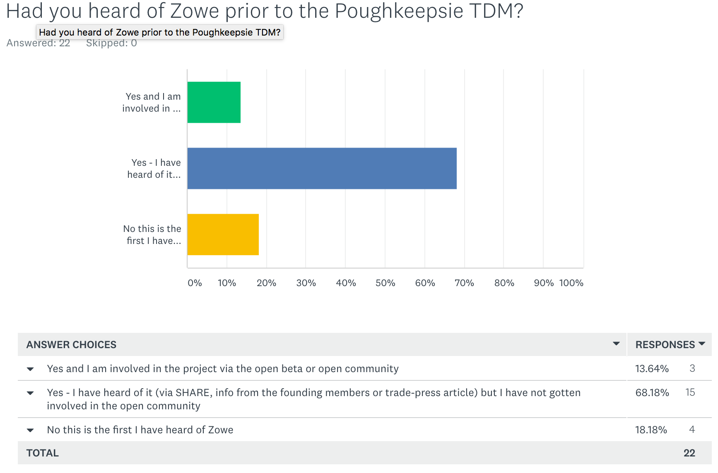
ISV Survey Results
82% of TDM attendees had heard of Zowe
But only 3 (13%) had engaged with the community
TDM was the first time 18% of participants heard of Zowe

Slide 6
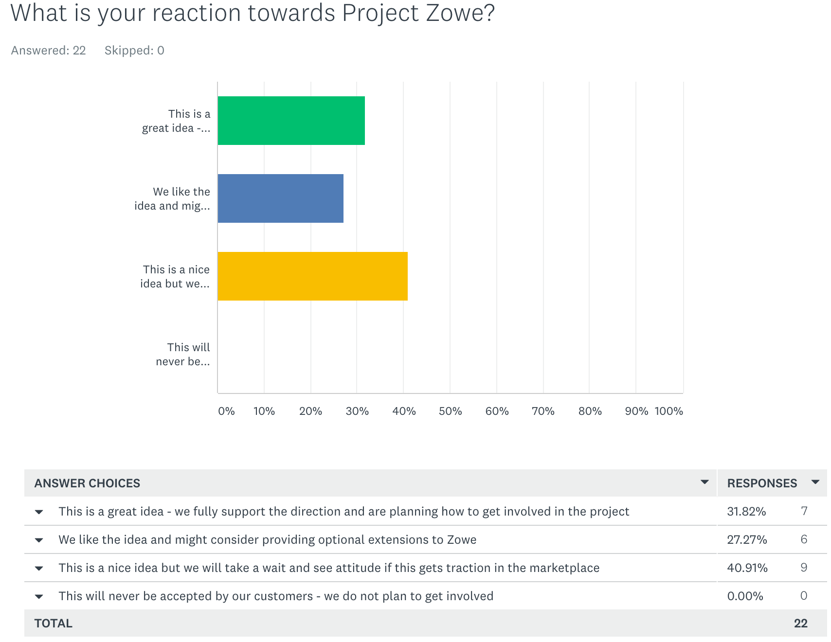
ISV Survey Results
60% of TDM attendees fully support the Zowe initiative and/or are considering building Zowe extensions
40% (9 companies) are waiting to engage until Zowe gets more market traction

Slide 7
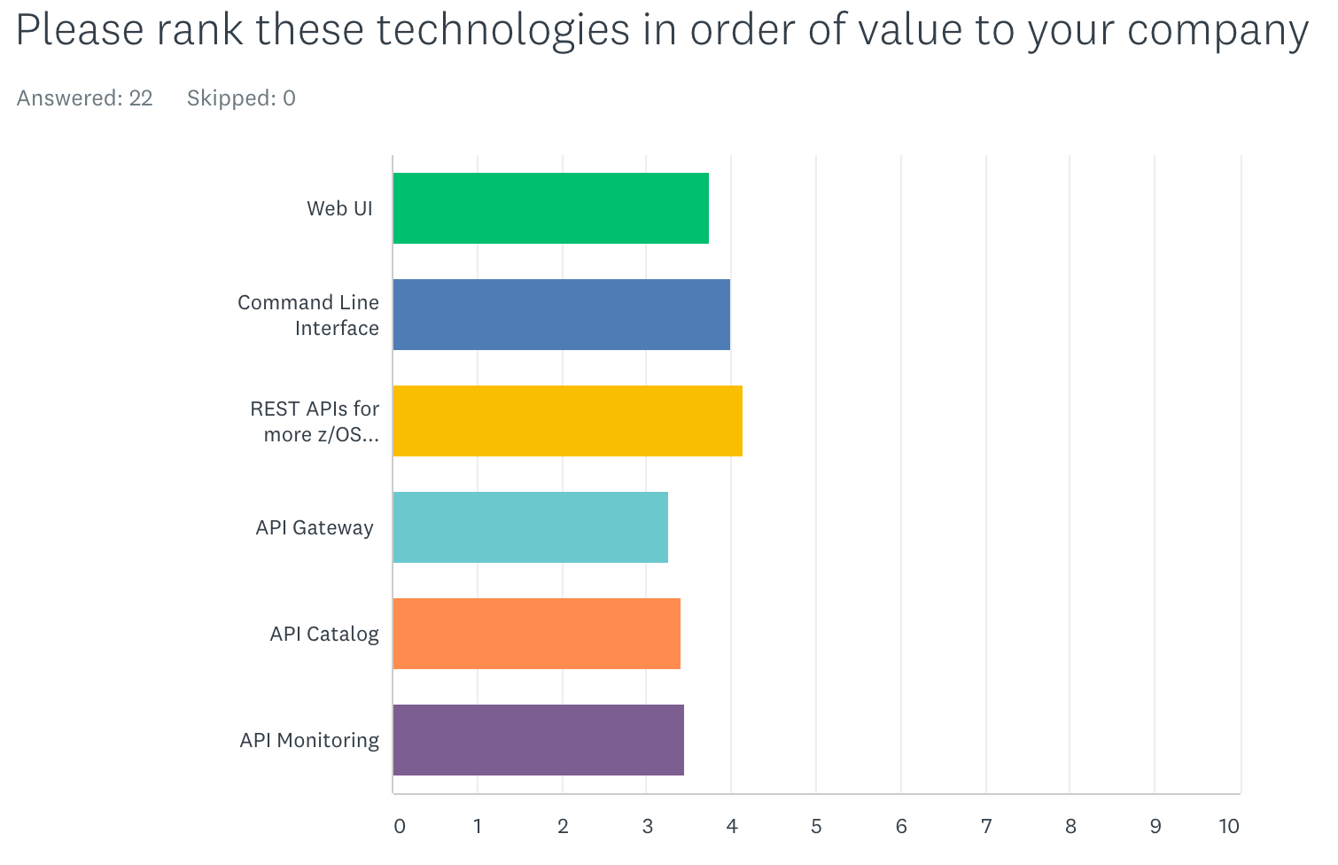
ISV Survey Results
Of those who had heard of Zowe prior to TDM, in order of most perceived value:
REST APIs for more z/OS services and products - AVG 4.33 (earning nine 5.0s)
Command Line Interface - AVG 4.11
Web UI - 3.88
API Monitoring - 3.61
API Catalog - 3.58
API Gateway - 3.41

Slide 8
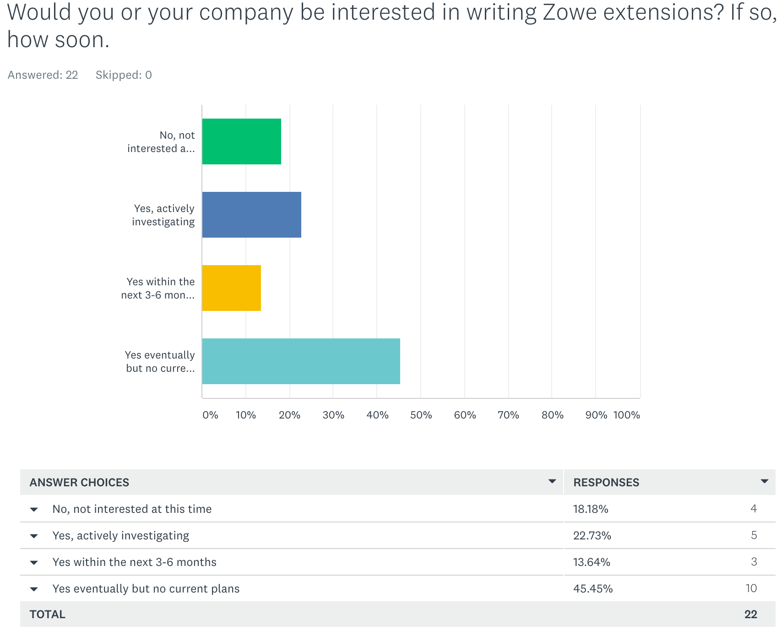
ISV Survey Results
Of those who had heard of Zowe prior to TDM, 83% said they are interested in writing extensions
However, 44% had no current plans

Slide 9
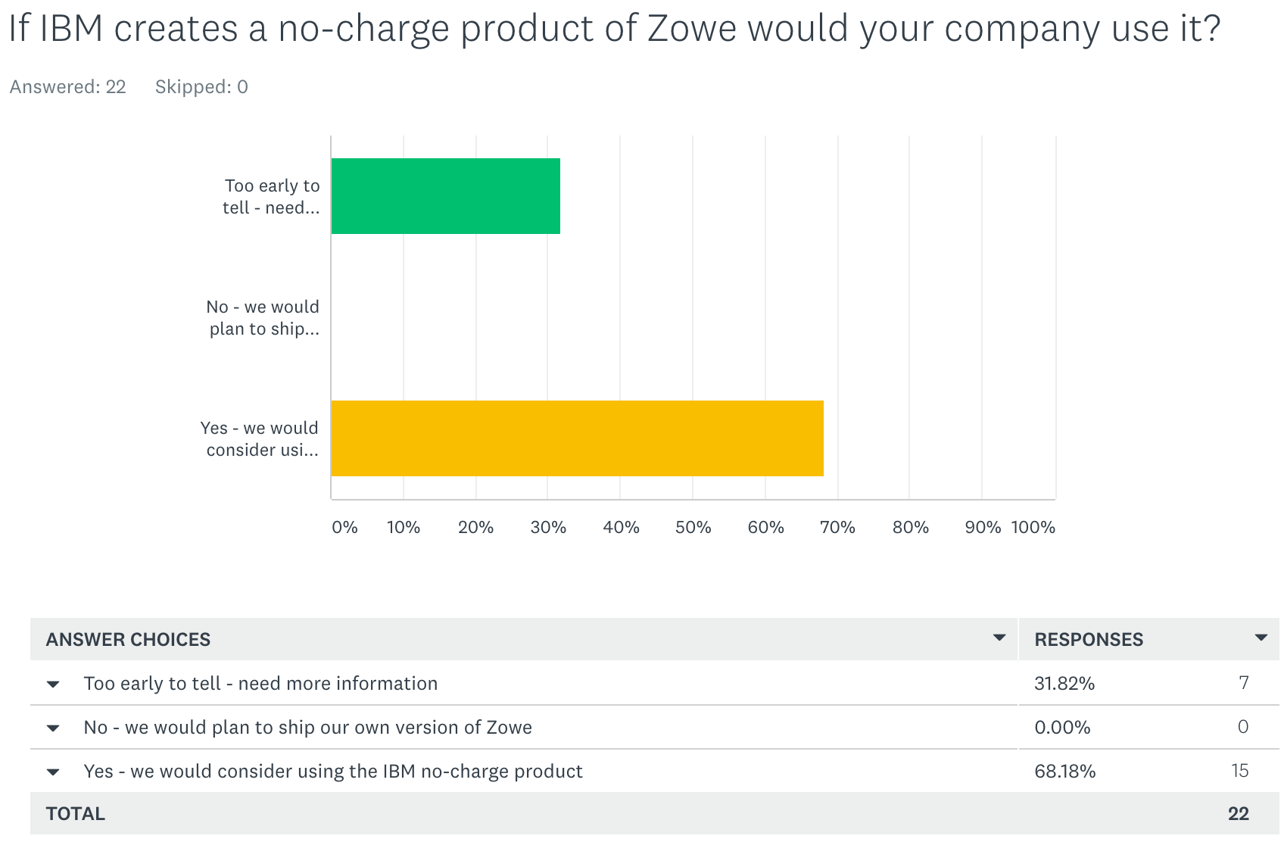
ISV Survey Results
Of those who had heard of Zowe prior to TDM, 66% said they would consider using an IBM PID

Slide 10
ISV Survey Results
What capability would you like to see added to Zowe in the future?
“Build into z/OS”
-App Dev.
“3270 to HTML mapping if it is not already there. Some customers want the HTML INTERFACE BUT do not want TO CHANGE their application code to facilitate HTML.”
-AVP R&D
“Better monitoring of each subsystem that is started.”
-Anonymous
“A capability like ISPF Workstation (using the same port), this will give CS additional resources to put at ISPF instead of continually rebuilding ISPF WS as each version of Windows comes along.”
-Dev.
“Merge with z/Connect and replace Eclipse requirement.”
- Owner

Slide 11
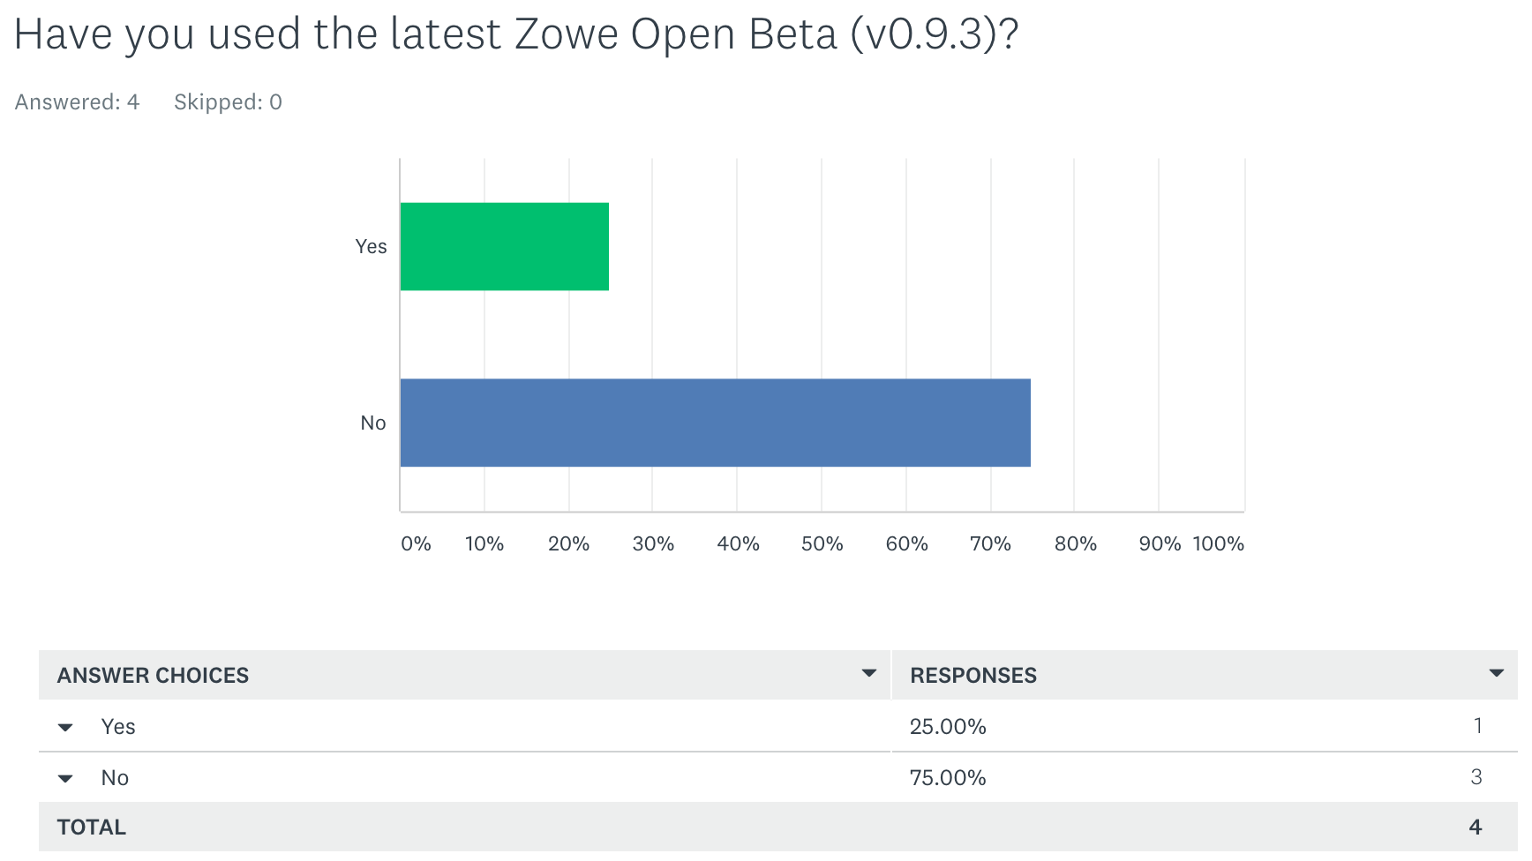
Sponsor User Survey Results
Only 1 Sponsor user had gone and installed the latest v0.9.3 beta build.

Slide 12
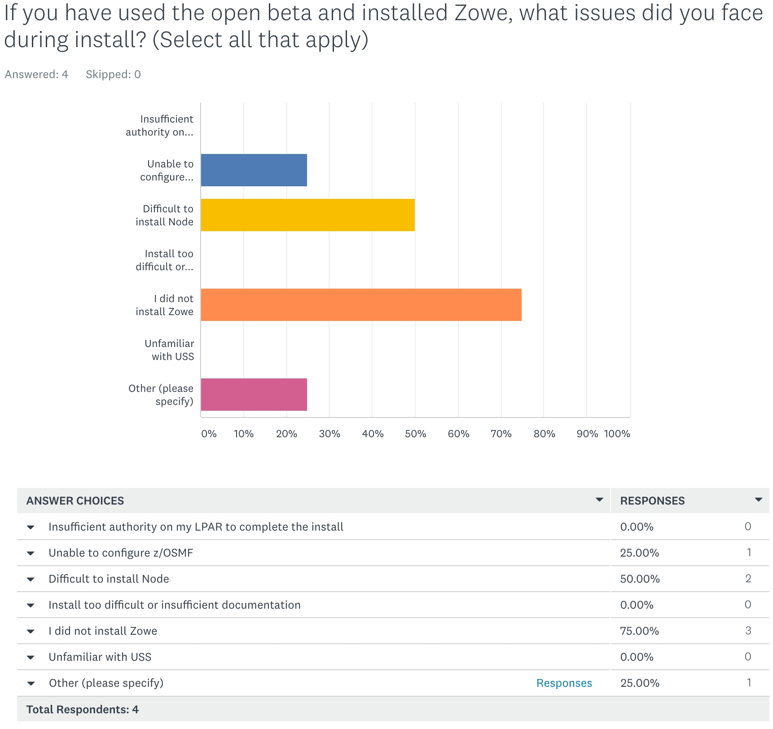
Sponsor User Survey Results
The one company who installed the v0.9.3 had issues installing Node. They also had a problem with space capacity on zD&T.
One other company had difficulties configuring z/OSMF as well as installing Node.

Slide 13
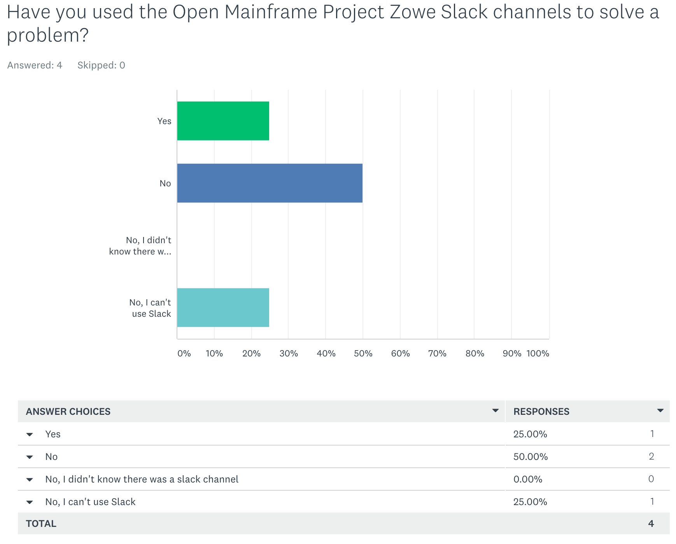
Sponsor User Survey Results
Only one sponsor user individual is engaged in the slack channels (it was not the one who had installation issues)

Slide 14
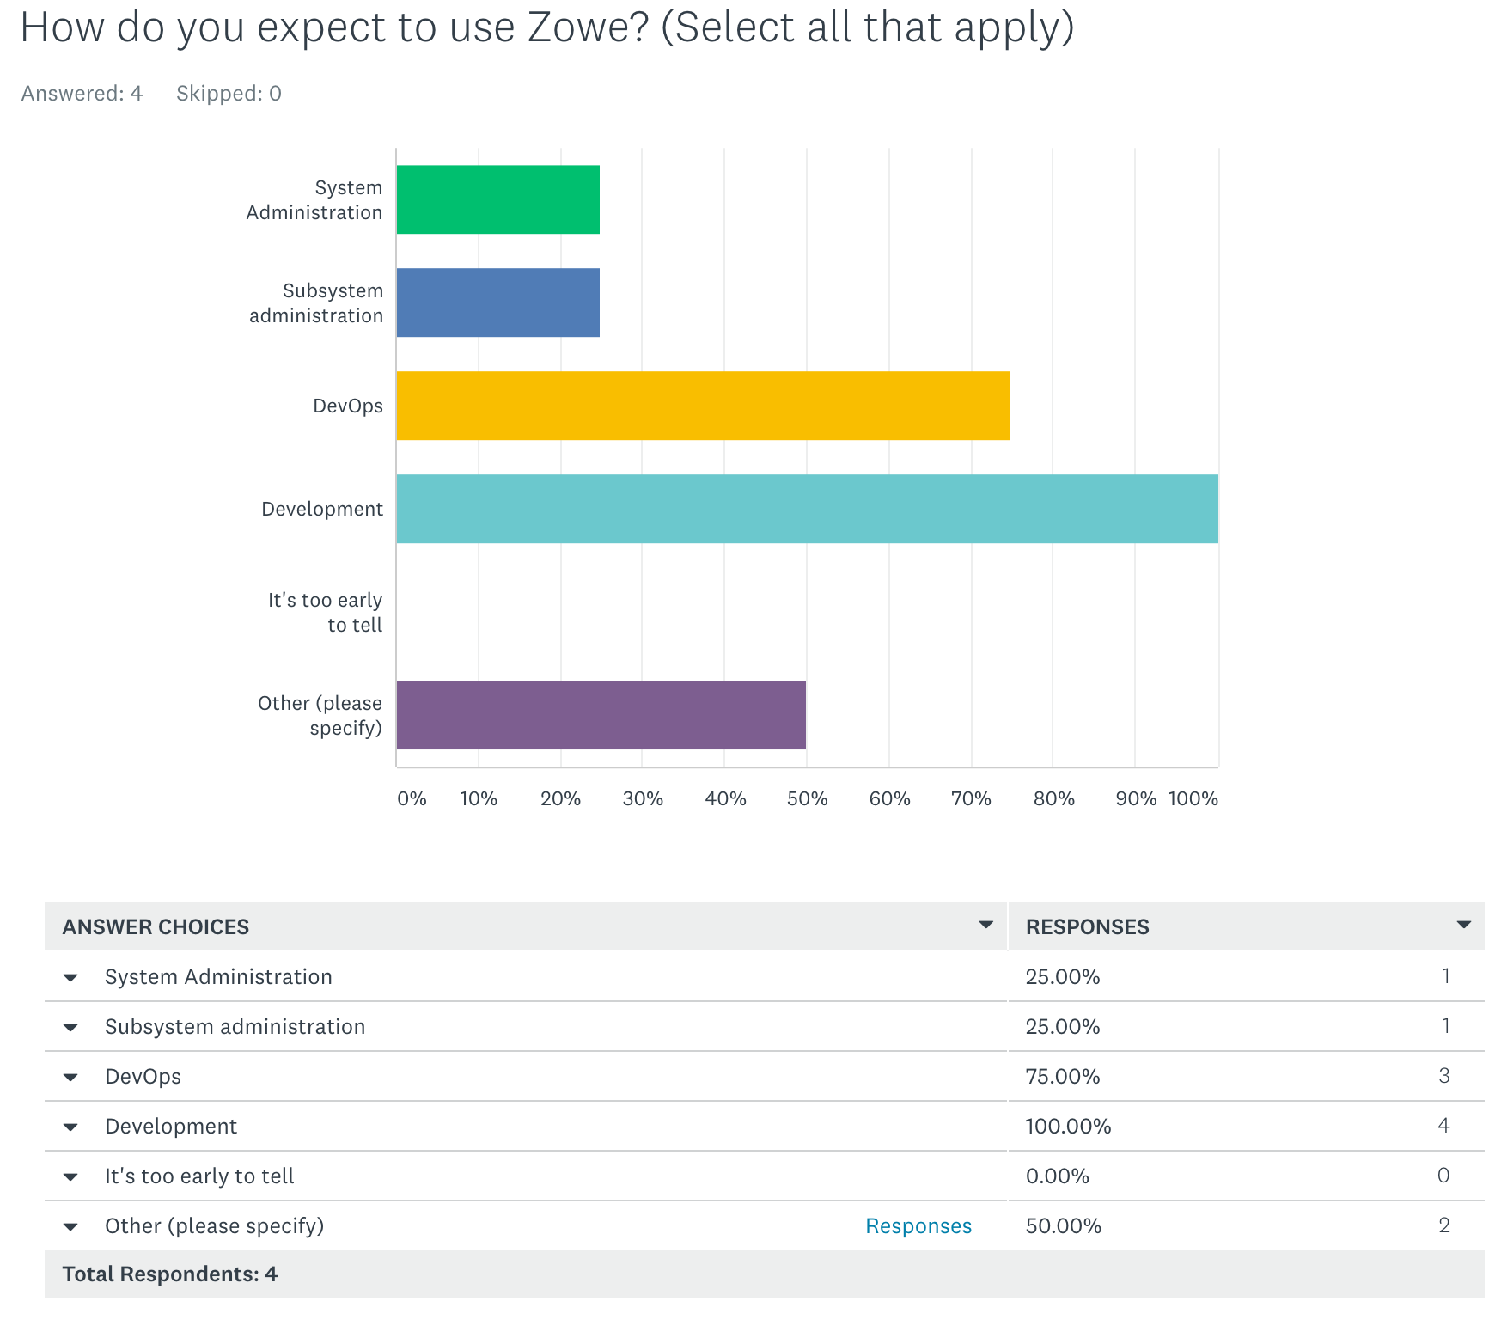
Sponsor User Survey Results
100% of respondents thought this would be useful for development.
75% of respondents thought this would be useful for DevOps
Only 25% expect Zowe to be used for System and Subsystem Administration
Other Comments about use cases:
New API service creation and share among community.
Want to install Node.js, as it will be useful for the future.

Slide 15
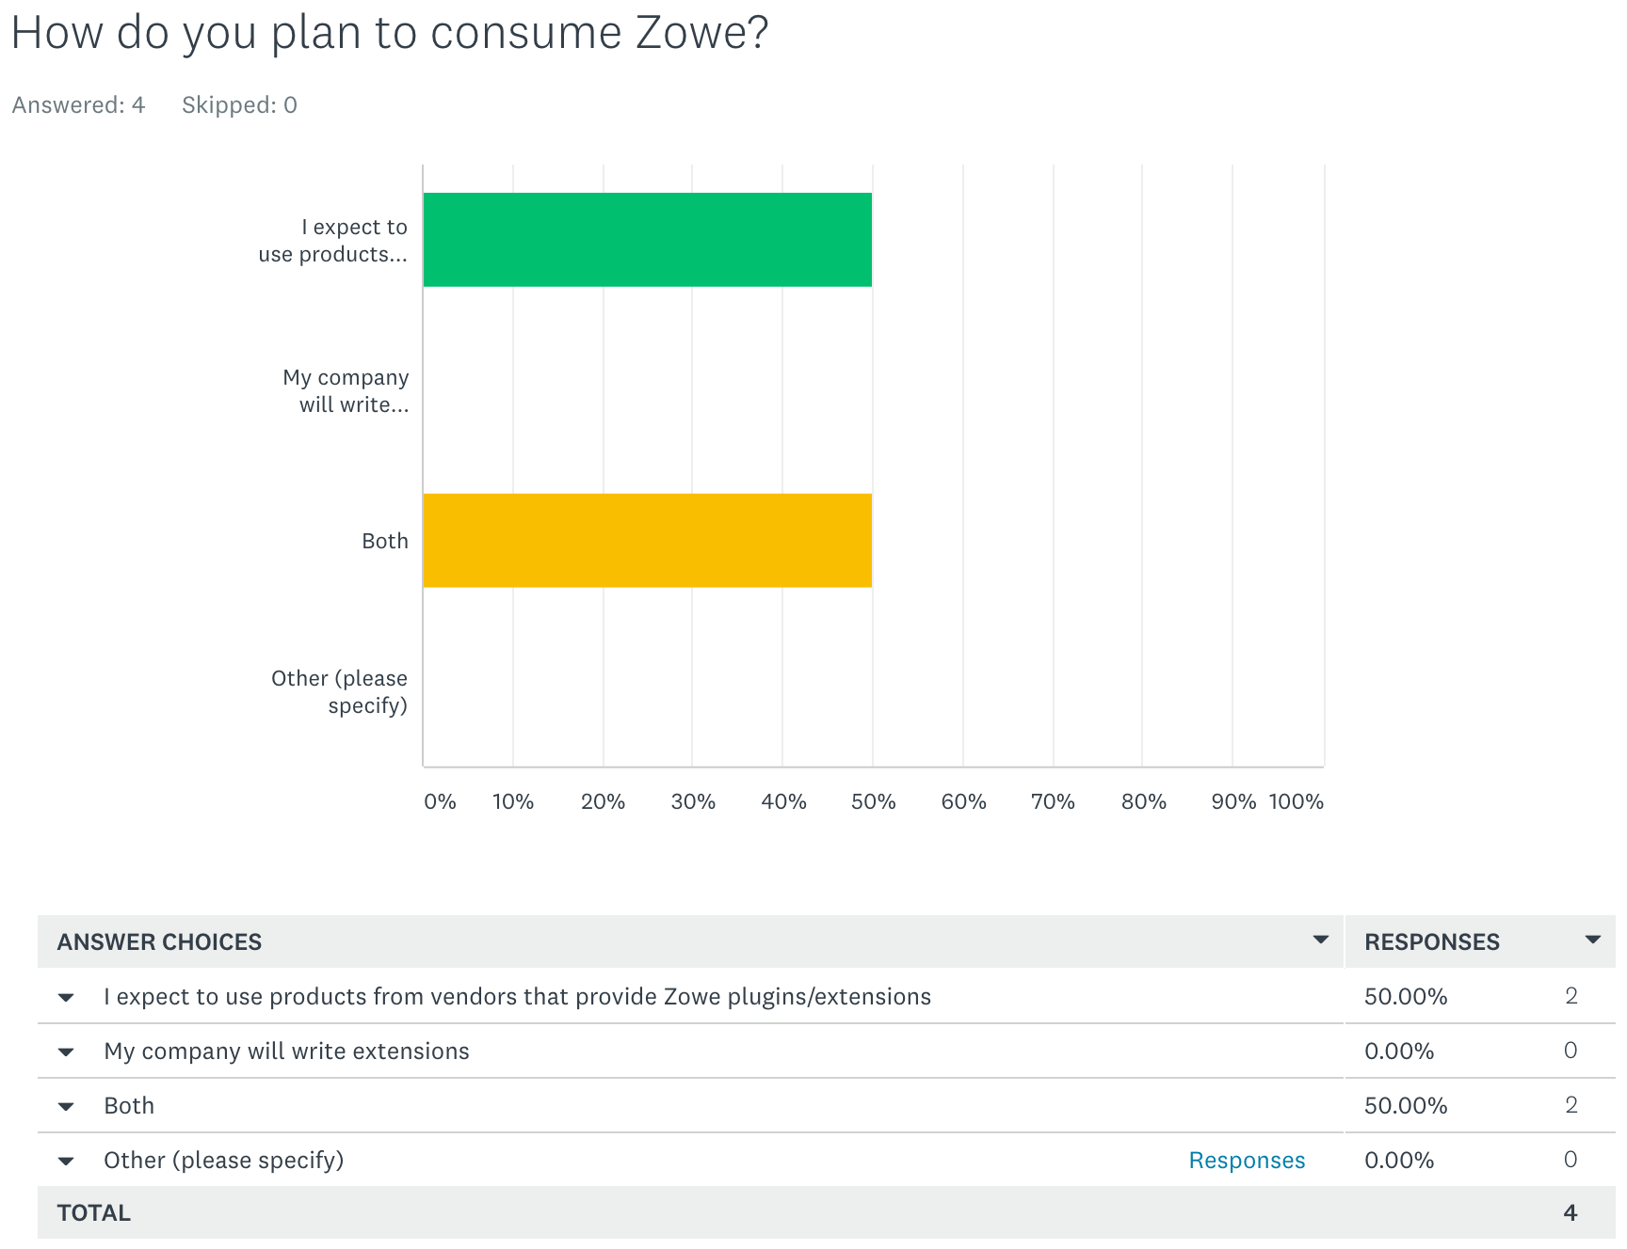
Sponsor User Survey Results
50% of respondents believe their company will consume Zowe by BOTH building their own extensions and consuming commercial offerings using Zowe.
50% only plan to consume Zowe via commercial offerings.

Slide 16
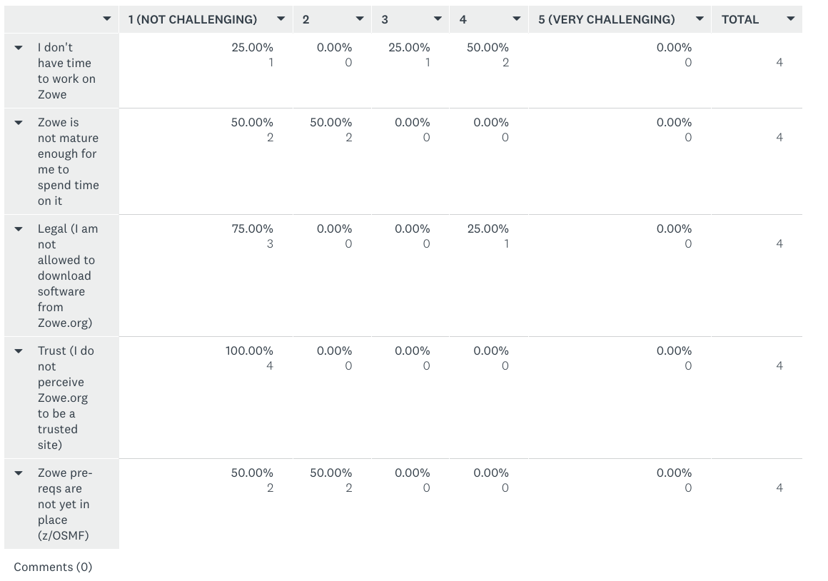
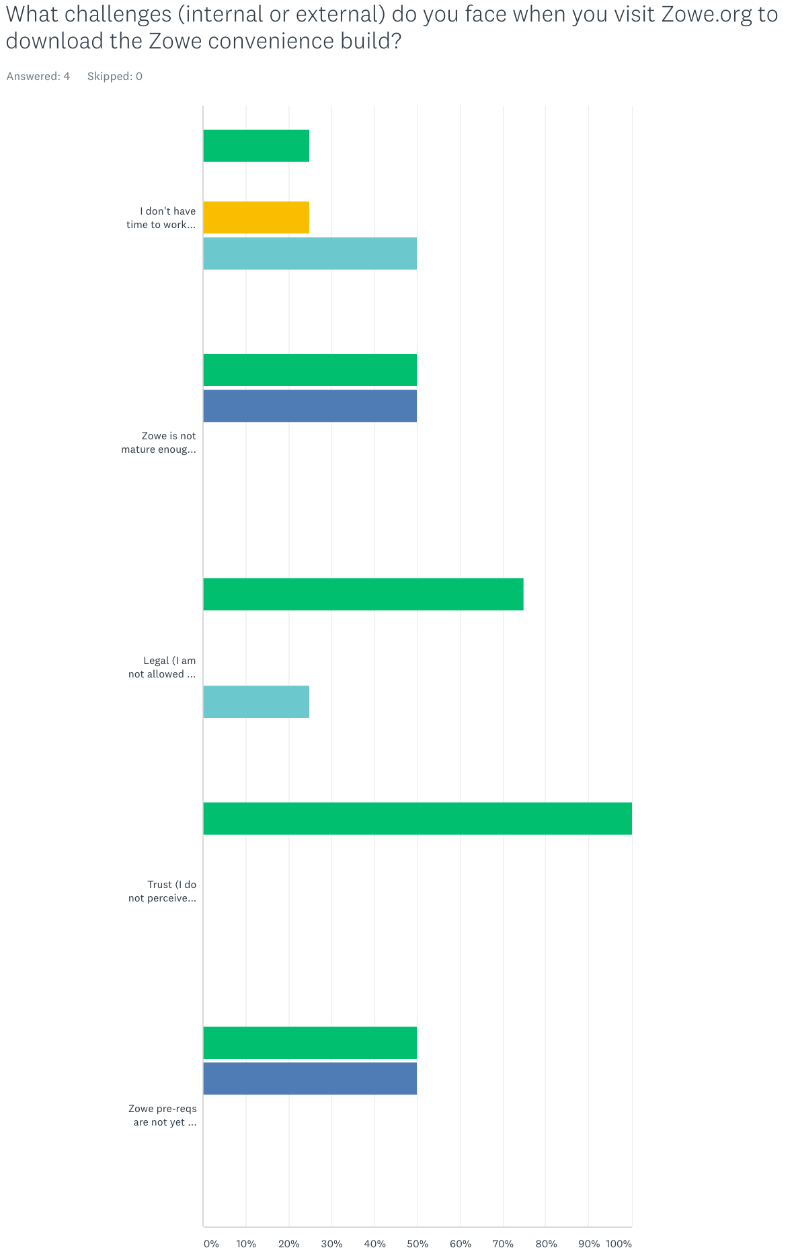
Sponsor User Survey Results
100% of respondents said they have no concerns with trusting Zowe.org
Time to work on Zowe was the most challenging factor for respondents

Slide 17
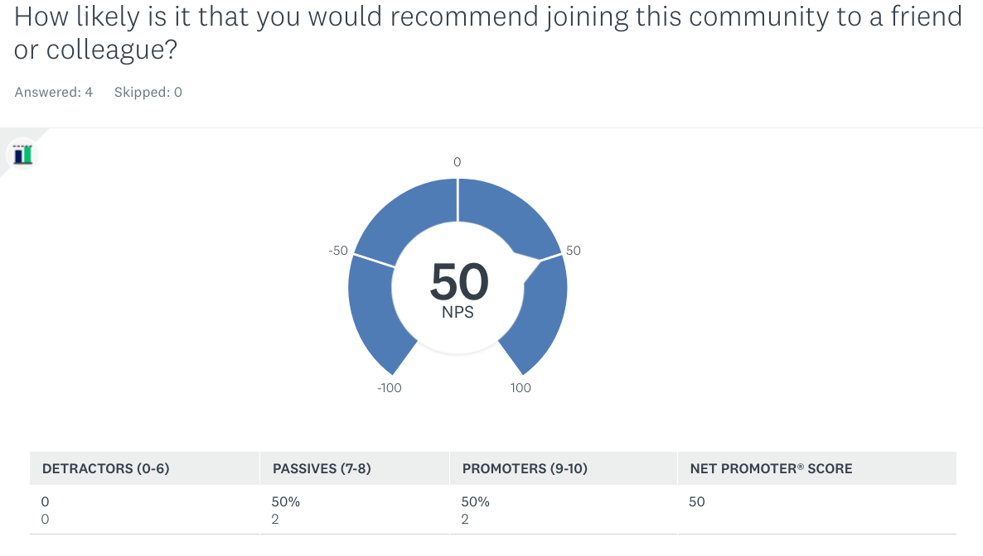
Sponsor User Survey Results

Slide 18
Sponsor User Survey Results
“This is a great move! Keep up the good work!!”
-Systems z Solutions Architect
“Wish to revisit Zowe in the future. Very useful product with lots of potential.”
-Integration Architect
“Unfortunately we're still waiting for our IBM mainframe support team to install the zOS components.”
-Mainframe Platform Architect

Slide 19
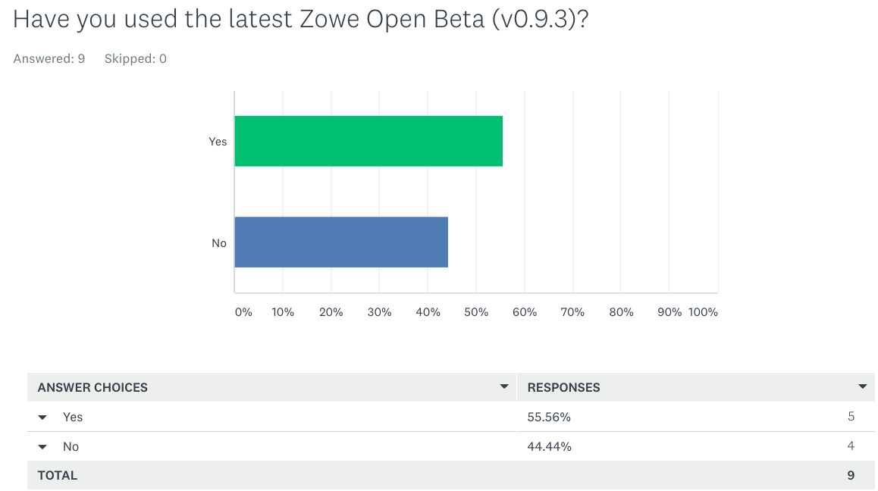
OMP Community Survey Results
Only 55% (5) of the 9 community respondents have installed the most recent beta download

Slide 20
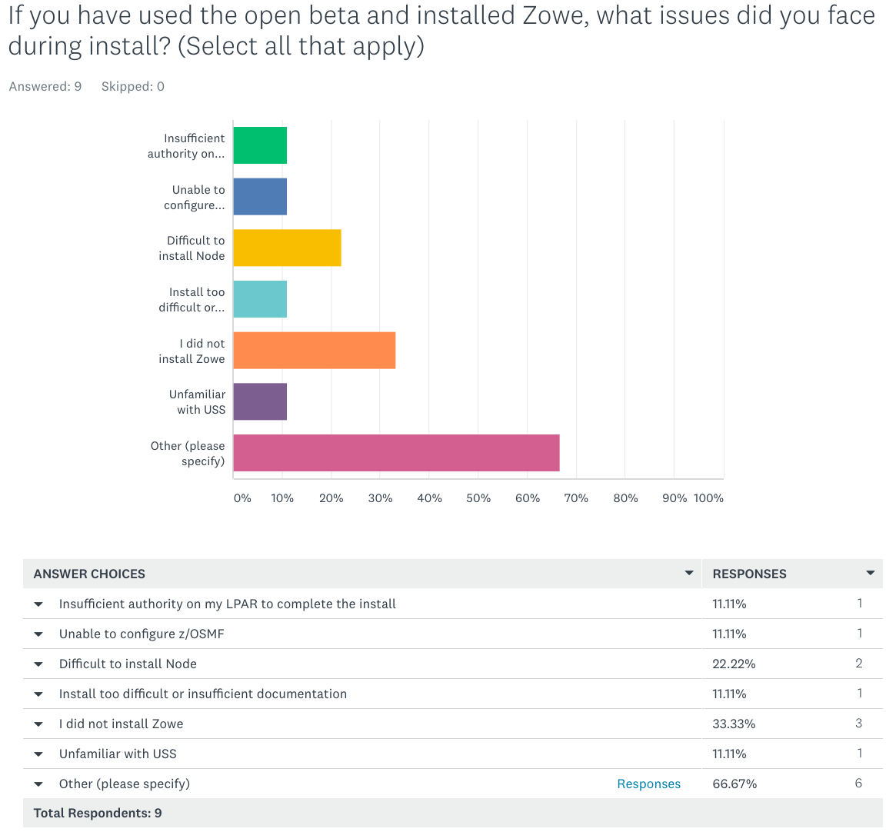
OMP Community Survey Results
Major issues with install included the pre-reqs of Node and z/OSMF
Reliance on other tools and SysProg authorities were among the top issues installing Zowe
Other Comments:
“Install not fully working and unable to identify the issue”
“making z/OSMF web service secure with valid certificate is hard - we still haven't seen the documentation about it”
“1. I was not able to install because I don’t have sysprog authorization. So I’m depending on willingness and priority of the sysprogs. 2. I tried to follow the guidance to install zlux if I don’t have an own z/OS instance but I can’t get the stuff from git due to firewall issues. 3. So I tried to install it om my own Linux environment at home. I registered for the open Source Development trial with Zowe but all I received was an e-mail with a login-id and password. What I also expected to receive was at least a hostname and port of a z/OS instance I could use. But received nothing. Only thing I get now is a Zowe logon screen but an error after entering logonid and password. 4. I’m stuck and forced to give up”
“many additional tools required (ant, ant-contrib,...). 'Build' cannot perform on z/OS.”
“Only installed CLI”
“The last install I did was 0.9.1. Not all directories were updated correctly. MVS, USS & JES required xml to be updated manually.“

Slide 21
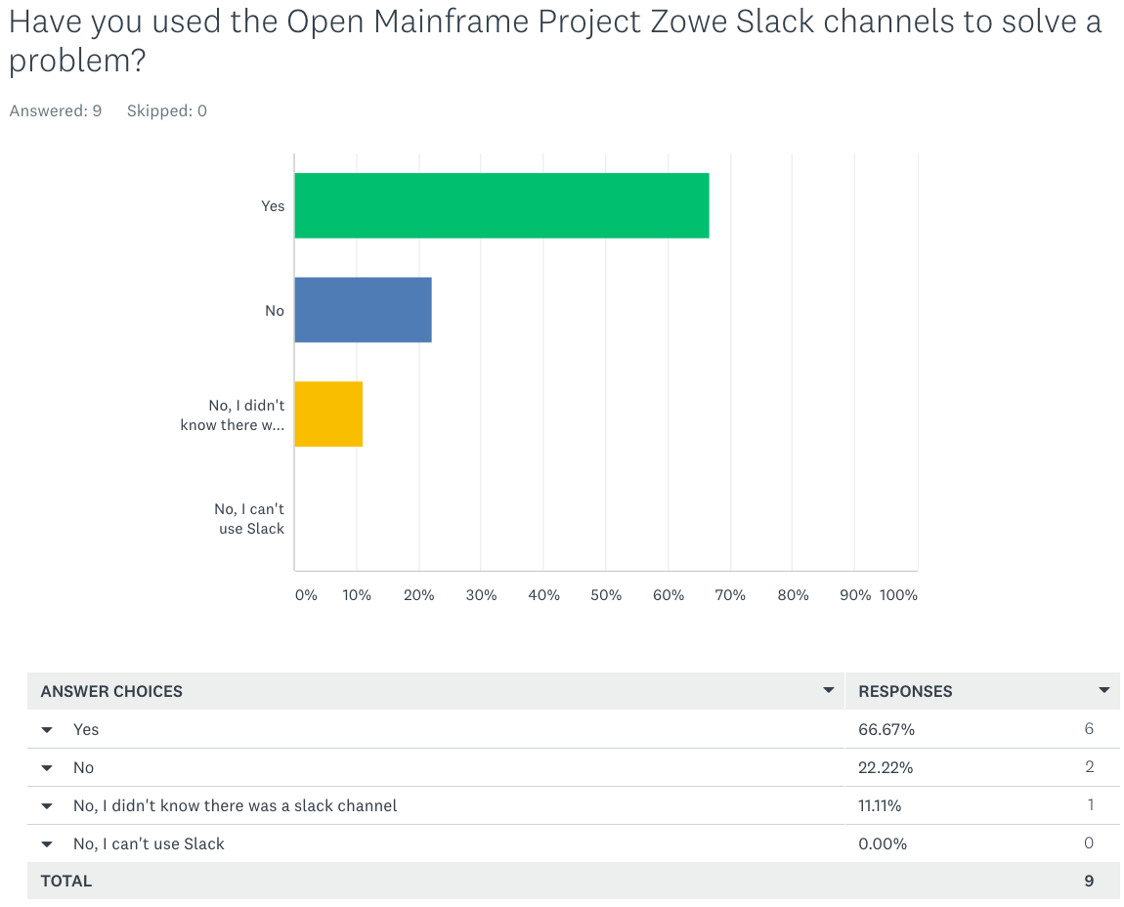
OMP Community Survey Results
33% of the OMP Community respondents either could not use slack or had engaged in the Slack Channels

Slide 22
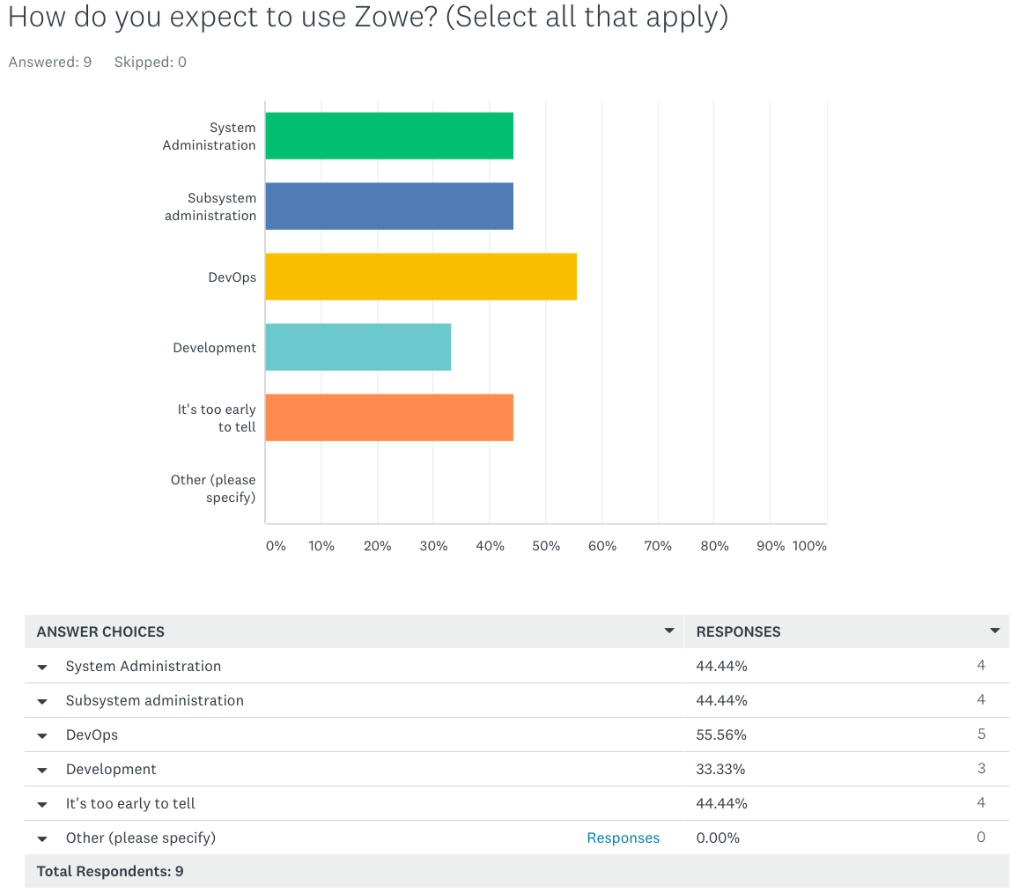
OMP Community Survey Results
55% of respondents expect Zowe to be used for DevOps
44% said it’s too early to tell

Slide 23
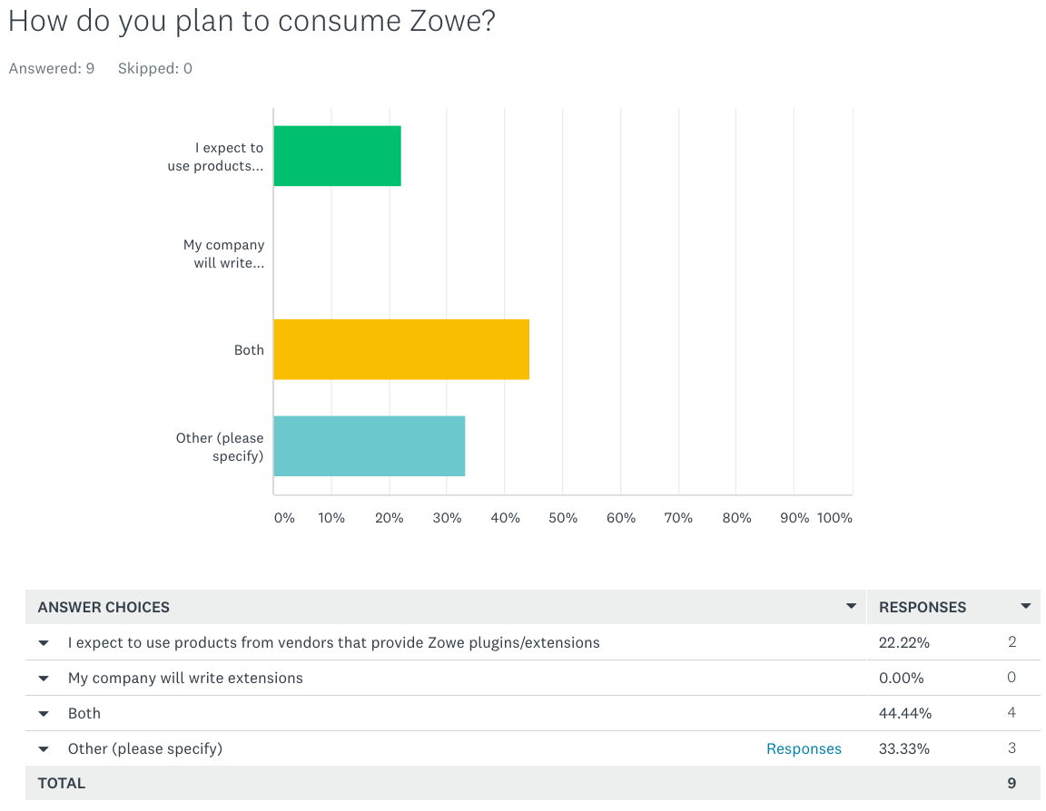
OMP Community Survey Results
44% of respondents plan to consume Zowe by both building their of extensions and consume commercial offerings leveraging Zowe
Other Comments:
“To early to tell“
“To early to tell“
“I stopped running Zowe as it consumed far too much CPU resources when ‘inactive’”

Slide 24
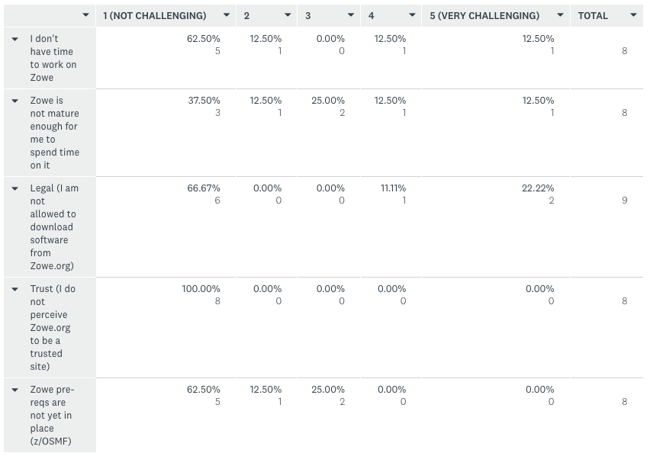
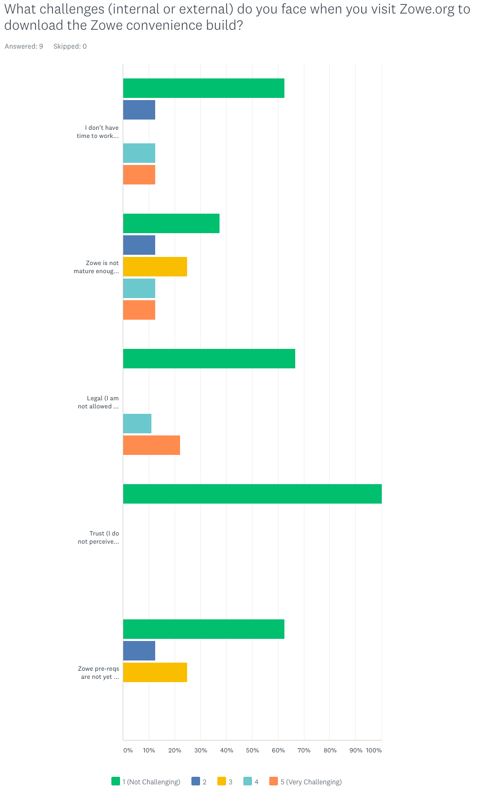
OMP Community Survey Results
100% of respondents said they have no concerns with trusting Zowe.org
The most challenging factor working with and downloading Zowe is that is it not mature enough

Slide 25
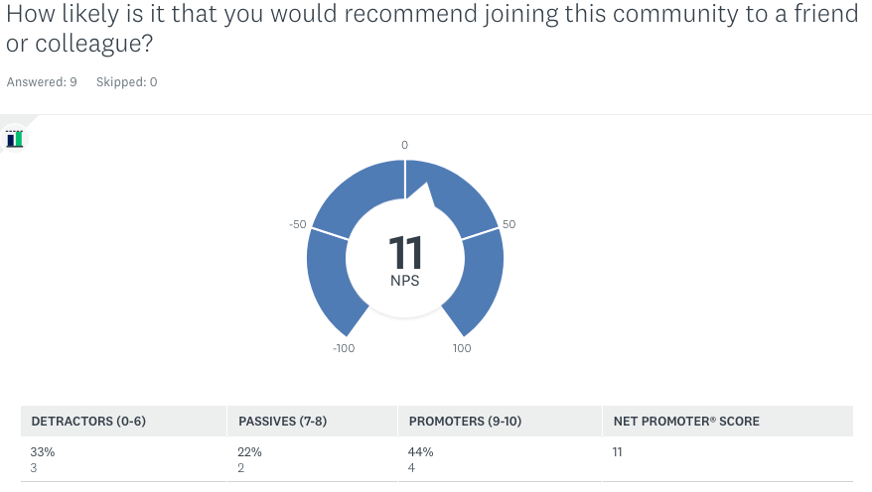
OMP Community Survey Results

Slide 26
OMP Community Survey Results
Other Comments:
“There are too much dependencies with Infrastructure department that makes it difficult to get Zowe installed. Also firewall issues stopped me to get code from git. As long as this isn’t solved my guess is that interesting in using Zowe is gone very soon. I think you must come up with a solution that makes it possible for an individual to play around with Zowe at home. It seems a z/OS instance is absolutely needed. So provide an unlimited free instance of a z/OS instance for community members. For example a small instance in the cloud, z/OS in a container that I can install locally (same idea as images in Docker container), free ZPDT, etc.”
“It's hard to find some people to help me when I'm facing errors on Zowe. Of course I have got many helps from slack channel, but there's still some problem can't get answer from slack. I even opened issue in github, but no one's looking. No one seems to be responsible for this issue. This is a big concern for me, how can I fixed the issues I met? Thanks!”
“Consider corporate proxy servers when installing Node packages from public registry.”
“many issues still not fixed. I reported many problems on the slack channels and bug issues in github.”
“Better/Complete installation and Configuration documentation is the best thing that can be done to help folks get up and running so they can see the benefits of Zowe. I've seen a lot of questions related to this and if someone is working this as a "side" project the difficulties may be enough to put them off of Zowe for good even though I would disagree with them.”
“I miss an integration view on the product. It's as if zowe will run on his own server while typically on z/OS it will be running together with numereous other services. All have to be manageable thus must be aware they will not be alone to use resources like ports, processes, ...”
“zowe consumes far too much CPU resources.”

